Slide 1
B4P Beyond Former Performance.
A powerful programming language and analytics engine
enabling rapid transformation of big data into powerful insights
Transforming Big Data into Powerful Insights
Version 8.03 'The Tabulating Machine' (2021-05-27)
Image source: Amir Hanna, Rush Hour in Dubai / UAE, unsplash.com.
Copyright © 2007: 2021 by Georg zur Bonsen, Baden / Switzerland

Slide 2
B4P Data Integration and Analytics Engine Overview
Multiple complex
data sources
B4P Data Integration and Analytics Engine
Integrated analysis
in seconds
data files
B4P
spreadsheets
X
X
databases
web data
>b4p
b4p
interactive
processing
batch
programs
data files
Excel, XLS, CSV, XML, JSON, HTML, Zip, Text (and others)
Data Sources
databases
Database exports (Salesforce, Oracle, SAP, FileMaker, et al)
web data
Internet sources of structured data (websites, web services)
other data
Statistical (R, SAS, SPSS, Stata), PDF (via Tabula)

Slide 3
Table of Contents
1
Problem Statement
2
B4P Data Integration and Analytics Engine
3
B4P Language
4
B4P Program Examples
5
B4P Real-world Use Cases

Slide 4
Problem Statement Current methods of analytics automation are complex, expensive, and opaque
Write Excel Macros
(Visual Basic)
OK for simple tasks, but ...
Coding becomes cumbersome if problems are more complex. Vulnerable if data format changes.
Processing performance drops significantly when working with large data volumes.
Opaque, un-auditable, poorly performing code if tasks are not very small and simple
Write a Computer Program
(C, Java, Python, SAS etc.)
Runs fast, but takes a lot of time to program, debug and optimize.
Others may have difficulties to understand what you have written.
Such programs end up very large, with many functional details coded by hand.
Good programming know-how, ideally object-oriented programming skills are needed, as well as obtaining a suitable development environment.
Resulting code cannot be understood, shared, managed, nor adapted by business users.
Hire a Consultant
(or two)
They are happy to solve your problems for cash. Solutions are quite decent, but ...
... if you need further enhancements, they will ask for more cash.
You end up depending on them, and you need to repeatedly convince your boss that the updates are worth the money.
Expensive, external vendor dependency, no long-term sustainability

Slide 5

B4P Low-Code Integration and Analytics Engine Solution Overview
Many complex
data sources
X
X
B4P
1
2
3
4
5
6
7
8
Import
Clean
Validate
Merge
Augment
Analyze
Format
Export
Load data from files: Excel, CSV, HTML, XML, JSON, ZIP, TXT
Load data from web pages
Load data from database exports
Search and Identify any files to import
Clean syntax
Check and align headers and structure
Explore and extract sub-tables
Filter out data not needed
Align number formats
Identify relevant data
Harmonize terminologies
Resolve inconsistencies
Fill missing data
Eliminate duplications
Merge multiple tables
Consolidate individual tables
Compare tables
Identify commonalities in multiple tables
Eliminate redundancies
Retrieve data from lookup tables
Add new calculated fields
Enrich the information value
Analyze
Calculate
Pivots
Sort contents
Statistics
Align results
Sort and arrange rows and columns
Format numbers
Add style, formats and colors
Save data to files: Excel, CSV, HTML, XML, JSON, ZIP, TXT
Initiate database imports
Trigger other software that data is available
Integrated analysis completed in seconds

Slide 6
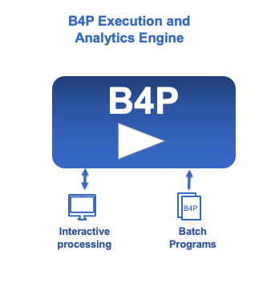
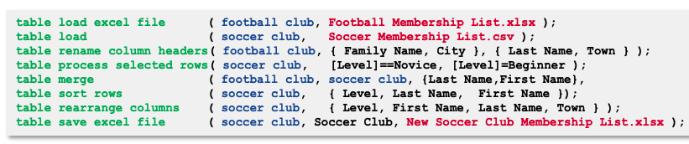
B4P Low-Code Integration and Analytics Engine Main Components
The B4P Engine
The B4P Language
The B4P Engine is designed for extreme performance managing Big Data – processing tens of millions of rows of data in seconds on commodity personal computers.
The B4P Language is a Low-Code, Domain-specific Language designed specifically for tabular data, and has over 800 functions built in.
Extremely Fast: Compiled and runs ‘on the metal’ to the peak performance of the very latest 8-core and 12-core processors from Intel and Apple (M1).
Extremely Light weight (< 3 MB installation footprint).
Extremely Secure. No connection to any ‘cloud service’. Runs 100% on standalone personal computer fully isolated within the corporate network, thus allowing safe use on highly confidential corporate and financial information.
Extreme Reliability. No Dependencies. Once installed there is no means for software to ‘break’ as it has no dependencies.
Many data formats supported (Excel, HTML, XML, JSON, text files, etc., full UNICODE)
Principle of Low-Code Approach: Few statements suffice
Simple syntax: Easy to read, learn, understand and run
Extensive library: Over 800 powerful functions built-in, with easy extensibility for new functions.
Compact methods for powerful processing steps eliminates need for complex code, loops, or other administrative overhead.

Slide 7
B4P Language Provides Highest Code Performance and Efficiency
High
The B4P Language is a Low-Code, Domain-specific Language for tabular data, and has over 800 functions built in.
B4P
C / C++
High performance Big Data Processing
Code Performance: Processing very large tables and variables is B4P’s core functionality
Code Efficiency: Single statements replace need for 10-50 lines of code in other languages
Low Code: Delivers solution with minimal coding
Maximum functionality with fewest lines of code
Flexible Variable Structure
Assign variable and table names as you wish, including spaces and special characters, directly and indirectly
Dynamically build up variable structures and reshape them when needed.
Optimized for Simplicity of Coding
Function library and semantics allow for flexible and powerful operations without loops and variables
Example: table process ( ... )
Programs are Portable across all Platforms
B4P program are fully portable, sharable, and executable across all operating systems (Windows, Linux, MacOS) and all computer architecture (Intel x32, x64; ARM M1), assuring maximum re-use across the enterprise.
Python
(with Pandas)
(Speed to run)
R
Code Performance
SAS
Excel
Visual Basic
(processing tables)
Low
Low
Code Efficiency
High
(Speed to develop and deploy solution)
B4P is highest in both Code Performance and Code Efficiency,
providing complete solutions with less than 10-20 lines of code

Slide 8
B4P Language Key Features
Simplicity
Performance
Flexibility
Portability
Easy to read und understand
Close to natural language.
Clear syntax easy to read.
Compact and powerful semantics.
Big Tables are the DNA
Language semantics are built on processing tables easily.
No external libraries needed.
Low Code - Very Compact
Achieve the most with few lines of code in step-by-step approach.
No hassle with declaring variables, memory management, etc.
High Power Density
High coding density translates into maximum machine performance.
Rich Function Library
More than 800 functions available and growing.
Many functions process very large tables, sets, matrices and other structures.
Broad spectrum of other general purpose and file system functions.
Advanced flow control functions going far beyond for, while and if.
Code in Function Parameters
B4P supports code passed as parameters to functions which are then executed when needed.
Makes operations possible without using variables and loops.
Colorful & Formatted Output
B4P supports a rich library to create Excel and HTML files with rich formatting, autofilters, etc.
Freedom of Naming
Full naming flexibility (all characters, incl. space) for variables, tables and headers.
Create variable names from other data, e.g. table header names.
Multiple word function names
Flexible Variable Structure
Create and work with simple variables, parameter sets, structures and arrays.
Supports complex variable tree structures in a simple way.
Libraries
Import libraries or create your own libraries to optimize your programming efficiency.
Cross Platform Portability
B4P programs run under Windows, LINUX and MacOS (incl. M1) without adaptations.
No need to change path names to run on other OS environments.
File and Data Formats
Supports CSV, HTML, Excel (with formats), JSON, etc. transparently.
UNICODE
B4P is fully UNICODE compatible, and accepts all UTF character formats on top of legacy formats.
Standard I/O
GUI intentionally not supported to preserve cross-platform portability.
Same console I/O feature set across platforms, incl. text colors.
Embed B4P in batch programs
The B4P Language allows one solve complex problems with clear, simple, minimal code
Focus on the what, not the how.

Slide 9
B4P Examples

Slide 10
B4P Example #1 Merging Two Soccer Clubs
Football Membership List
Merged Membership List
4P
B4P
Soccer Membership List
Task: A new football club should be created by merging two existing sports clubs:
The tables of the two clubs are arranged differently and use different naming schemes (e.g. qualification levels)
Some people are members in both clubs and need to be resolved properly.
Highlight possible inconsistencies (red text color)

Slide 11
B4P Example #1 Merging Two Soccer Clubs
Solution: 8 Statements.
1
Import
table load excel file ( football club, Football Membership List.xlsx );
table load ( soccer club, Soccer Membership List.csv );
table rename column headers. ( football club, { Family Name, City }, { Last Name, Town } );
table process selected rows. ( soccer club, [Level]==Novice, [Level]=Beginner );
table merge ( football club, soccer club,
{Last Name,First Name},{Level,Town},append," or " );
table sort rows ( soccer club, { Level, Last Name, First Name });
table rearrange columns ( soccer club, { Level, First Name, Last Name, Town } );
table save excel file ( soccer club, Soccer Club, New Soccer Club Membership.xlsx );
Simple statements
Easy to read multi-word names
Functions, variables, tables, etc.
2
Clean
Rich and flexible function library
No or just small number of loops and variables needed for coding
3
Validate
4
Merge
Full Excel support
Loading and saving
Full data transparency
5
Augment
Portability ensured
Statements are independent from platform and output format
6
Analyze
8
Export

Slide 12
B4P Example #1 Merging Two Soccer Clubs
Solution: 8 Statements. Formatting: 5 Statements.
1
Import
table load excel file ( football club, Football Membership List.xlsx );
table load ( soccer club, Soccer Membership List.csv );
table rename column headers. ( football club, { Family Name, City }, { Last Name, Town } );
table process selected rows. ( soccer club, [Level]==Novice, [Level]=Beginner );
table merge ( football club, soccer club,
{Last Name,First Name},{Level,Town},append," or " );
table sort rows ( soccer club, { Level, Last Name, First Name });
table rearrange columns ( soccer club, { Level, First Name, Last Name, Town } );
table style table ( soccer club, sheet, freeze rows, 1, autofilter, 0 );
table style auto width ( soccer club );
table style rows ( soccer club, 0, sheet, boldface, true, fill color, gray 15 );
table process selected rows ( soccer club, ([Level] = '*Questionable*'),
table style cells ( soccer club, Level, row(), single, text color, red ) );
table save excel file ( soccer club, Soccer Club, New Soccer Club Membership.xlsx );
2
Clean
3
Validate
4
Merge
5
Augment
6
Analyze
7
Format
Highly powerful formatting functions
Small number of statements suffice
8
Export

Slide 13
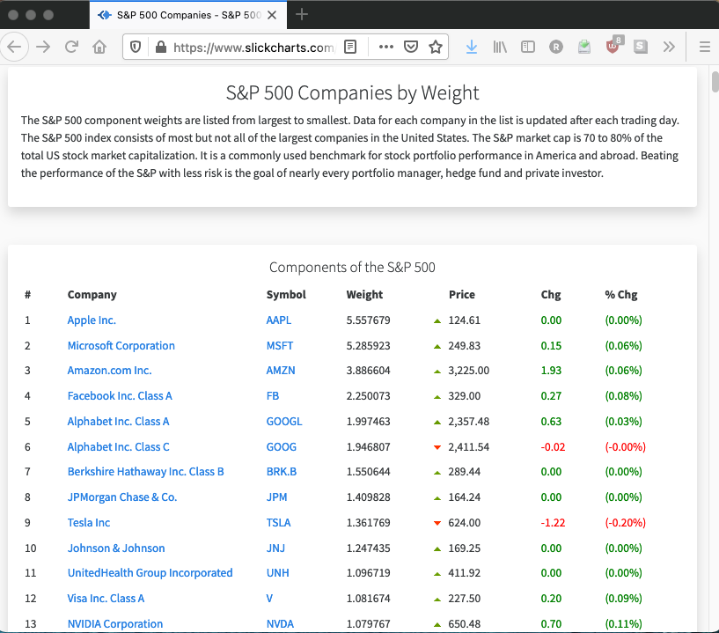
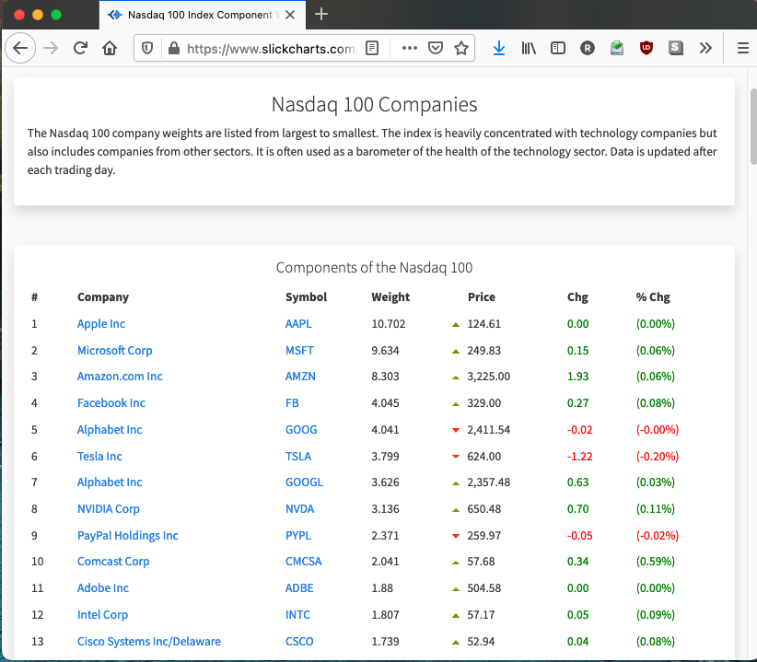
B4P Example #2 Combine Online Stock Data: SP 500 and NASDAQ 100
B4P
Task: Import the SP 500 and NASDAQ 100 listings and merge them
Data source1: https://www.slickcharts.com/nasdaq100
Data source2: https://www.slickcharts.com/sp500
Some companies are listed in only one of them, others are listed in both.
Combine the information, show the weighting in the two listings and color the stock price developments

Slide 14
B4P Example #2 Combine Online Stock Data: SP 500 and NASDAQ 100
Solution: 12 Statements. Formatting: 6 Statements.
1
Import
for all parameters ( {nasdaq100, sp500} , listing[] )
{
file download overwrite ( "https://www.slickcharts.com/" + listing[], listing[] + .html);
table load ( listing[], listing[] + .html, HTML, "Components of the" );
table clean ( listing[], trim spaces );
table process ( listing[], ['% Chg']=smart numeral( middle( ['% Chg'], '(',')' )); [Price]=clean numeral([Price]) );
table rename column headers ( listing[], "Weight", "Weight " + listing[] ); // Weights are specific to Nasdaq and S&P
}
table merge extend columns ( nasdaq100, sp500, Symbol );
table rename ( sp500, stocks );
table sort rows ( stocks, Company );
table process ( stocks, ['#'] = row() ); // Number the items
table rearrange columns ( stocks, { '#', Company, Symbol, Price, Chg, '% Chg' } ); // Weightings follow afterwards
table style auto width ( stocks );
table style theme ( stocks, Zebra Vertical Lines, pattern, 2, table, "gridlines, false" );
table process ( stocks, // Negative numbers: red; positive numbers: navy blue
table style cells ( stocks, { 'Chg', '% Chg' }, { 2: row() }, single, text color, select if ( [Chg]>0, navy, red ) ) );
table style columns ( stocks, '% Chg', sheet, number format, "0.00%" ); // Value to show as percent.
table style table ( stocks, sheet, freeze rows, 1, autofilter, 0);
table save excel file ( stocks, "NASDAQ and SP500", Stocks.xlsx );
2
Clean
3
Validate
4
Merge
5
Augment
7
Format
8
Export

Slide 15
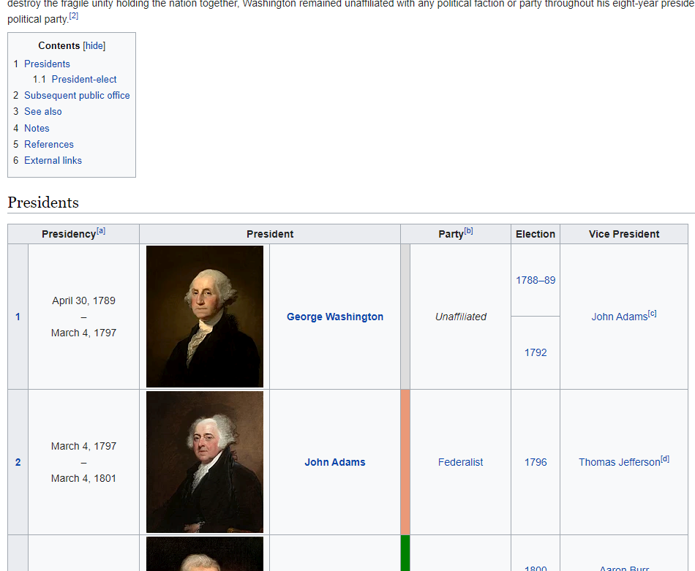
B4P Example #3 Analyzing all Presidents in Wikipedia
4P
B4P
Task: Download the list of Presidents and generate Excel table with one president per row
Data source: https://en.wikipedia.org/wiki/List_of_presidents_of_the_United_States
Some Presidents had multiple terms
Ignore the portraits
Some vice presidents had deviating terms
Remove redundant artefacts, e.g. cross-referencing symbols
Generate a nice table with parties colored differently

Slide 16
B4P Example #3 Analyzing all Presidents in Wikipedia
Solution: 9 Statements. Party-specific coloring: 6 Statements.
1
Import
file download overwrite ( "https://en.wikipedia.org/wiki/List_of_presidents_of_the_United_States", presidents.html );
table load ( presidents, presidents.html, HTML, 'id="Presidents"' );
// Strip all footnote references and new lines in the fields, and the last table row with footnotes inside
table delete rows ( presidents, table length( presidents ) -1 );
table process all cells ( presidents, [.] = replace all( literal([.]), { '[?]', new line}, '' ) );
// Remove the blank column originally containing portraits and put president name into all rows
table delete columns ( presidents, {Portrait, Party } );
table rename column headers ( presidents, {"Presidency (1)", "Party (1)"}, {Period, Party} );
table fill vertically ( presidents, President );
table consolidate ( presidents, President, { Election, Vice President }, append, ", " );
// Define party colors
table initialize ( party colors, {{ Party Name, Colors },
{ Democratic, blue}, { Republican, red }, { Federalist, coral }, },{ Unaffiliated, gray},
{ "Democratic- Republican", light green },{ Whig, yellow }, { National Union, ocre} );
// Add some colors and styles
table process ( presidents, table style cells( presidents, Party, row(), single, fill color, [ party colors : Party Name, [Party], Colors ] ) );
table style columns ( presidents, { "Presidency (1)", "President", "Vice President" }, sheet, column width, 30 );
table style columns ( presidents, { Party, Election }, sheet, column width, 20, horizontal align, middle );
table style rows ( presidents, 0, table, boldface, true );
table style table ( presidents, sheet, wrap text, true, autofilter, 0, freeze rows, 1 );
table save excel file ( presidents, All U.S. Presidents, presidents.xlsx );
2
Clean
3
Validate
5
Augment
7
Format
8
Export

Slide 17
B4P Real-World Use Cases

Slide 18


B4P Real-world Use Case #1 Integrating Corporate data from branch offices worldwide
Each region manages their own data in different database systems or manually with Excel
B4P
Region 1
Europe
Data
Collection
1. Load Data from all Sources
The data from different sites originate from 20 different database exports or manually prepared Excel files
Region 2
Europe
Data Pre-
Cleanup
The two Excel files are revolving, i.e. mutually used and updated by the user and the B4P program
2. Clean-Up and Harmonize
Harmonize data formats to week numbers and years
Excel
Region 3
N America
Align
Products
Vendor + Product List
3. Align Product Information
The revolving table manages the products to include and allow for using harmonized product names.
Orientation is by common product identification number.
Excel
Region 4
S America
Excel
Align
Projects
Project
List
4. Align Project Information
Different project names and/or abbreviations are used by the sites. They will be aligned.
Excel
Planning
Table
5. Project Name Alignment
The sequential list of individual demands is transformed to a horizontal planning table with weekly schedule.
Information consolidation and summing up
Region 19
Asia
Excel
Optional: Import supplier data
Supplier Data
6. Import supplier planning data
If supply info is available, then match demand with their delivery plans
Supplier Data
Excel
Region 20
Asia
Create final
reports
Supplier Data
7. Reports
Detailed internal reports for performance monitoring
Condensed reports for suppliers
Supply Chain
Reports
Excel
More than 20 different files!

Slide 19
B4P Real-world Use Case #2 Information interchange between multiple different databases
Lookup Tables
e.g. exchange rates,
product portfolios
Excel
ERP
Site 1
B4P
Cloud based
CRM database
ERP
Site 2
Example 1:
Information about new orders booked into the ERP system will be reported to the CRM system in order to mark the opportunity as "ordered".
Data Xchg Reports
(e.g. changes,
inconsistencies)
Example 2:
Key dates (e.g. planned order date, delivery dates) for the same opportunity or order are different in the CRM and ERP system.
Report the differences, and, if allowed, use automated rules to resolve the inconsistencies
Excel

Slide 20

B4P Real-world Use Case #3 Enriched Business Intelligence from many data sources
Orders List
from CRM database
1. Load orders list
Load the files and make the numerals suitable for processing (e.g. remove thousand separators)
Filter
2. Filter
Delete orders not of interest
Delete orders with 0 EUR values
Treat opportunities of different natures individually
Expansion
6. Expand
Expand opportunities with multiple equipment suppliers into multiple rows and list the suppliers separately
7. Derive Equipment Values
Derive equivalent equipment values
Plausibility checks + adjustments against upper and lower boundaries.
3. Preparations
Harmonize similar company names
Align product prices so they represent similar scopes, all converted to EUR
Equipment
Supplier List
short names
Preparations
Excel
Final Cleanup
8. Final cleanup
Keep and rearrange columns of interest,
Discard the rest
Numeric output in commercial format
Xchg Rates
4. Consolidation
Identify multiple rows with same opportunity numbers (as they cover different product & aftermarket scopes)
Proper handling of traditional OEM business, consortia setups, aftermarket, etc.
Excel
Consolidation
5. Do some corrections
Make corrections if orders given to competitors appear over-/underpriced in order to eliminate distortion
Plausibility check of values of sub-system scopes vs. the whole.
Ouput: Market
Intelligence Data
Use Excel to visualize
Market development over time
Market development across regions
Market share among suppliers
Identifying market disruptions
etc.
Scaling
Factors
Corrections
Excel
x
✓
ERP = Enterprise Resource Management Databases (e.g. SAP, Oracle, BAAN, Abacus)
CRM = Customer Relationship Database (e.g. Salesforce)

Slide 21
B4P Beyond Former Performance.
Information
www.b4p.app
Europe
Georg zur Bonsen
+41 56 221 82 00 zur-bonsen (at) bluewin .ch
North America
Rafael M Richards
+1 202 469 15 27 rmrich5 (at) gmail .com
Contact
Presentation: Updated 2021-05-29

Slide 22
B4P Solution Supported Data Formats
Inputs
Outputs
Excel
XLSX, XSLM, open formats
CSV comma and tab separated files
Database Exports
HTML, MHTML and XML formats (depending what the database is producing). Examples: Salesforce, Oracle, SAP
JSON files (JavaScript Object Notation format)
CSV comma / tab / semicolon / ...symbol separated files
Other Inputs
Files with fixed columns on every row
Any other form of structured text files
ZIP files (B4P does data decompression)
Character Sets (both input and output)
UNICODE UTF-8 and UTF-16; Basic and extended multilingual planes
Legacy formats (like ASCII / Windows West Europe)
Unformatted Output for Excel
CSV comma separated files
Formatted Output for Excel (with colors, formatting and style)
XLSX (Excel 2007 onwards, in use today)
XLS (Excel 2003 XML format)
Unformatted and formatted output for Browsers
HTML (incl. colors, formatting and style)
XML (planned)
Output for other databases
CSV comma / tab / semicolon / ... symbol separated files
JSON files
Plain text files
ZIP files (B4P does data compression)
X
X
Additional data formats can be supported easily through B4P library extensions

Slide 23
Problem Statement Manual data integration and analysis is labor-intensive and error-prone
Start your data analysis task
Gather the Data by Hand from databases, tables, Internet, manual data collection, etc. Lots of mouse clickes to initiate all downloads
Exported Data: Cumbersome Format from databases, e.g. poor format, cryptic terminology
Foreign Characters Lost M?nchen
Incompatible Data Formats Excel cannot read it in or use it directly, data alignment needed. E.g. locality of numbers, dates.
Verify the Data Manually or semi-automatically on Excel
Errors Introduced
Missing Data, manual corrections and filling gaps
Combine Multiple Info Sources in order to see the big picture effectively, do various lookups by hand
Compare New vs Old Data on Excel. Time-consuming analysis of multiple lists along the timeline. Discovered important issues too late.
Excel too slow with Big Data loading and processing (3’000 … > 10 M rows)
waiting ... waiting ...
Clean-Up by Hand Unlikely to discover all issues every time
Condense and Align the data, do necessary sorting, build pivot tables, etc.
Do Needed Calculations in order to come closer to the results and verify them
Add Formatting and Style on the results, incl. comments, etc. by hand
Work completed: late, inconsistent, error-prone

Slide 24
Table of Contents
1
The Problem Statement
2
The Analytics and Execution Engine
3
Typical Use Cases
4
The B4P Language
5
Programming Examples
6
Backup Slides

Slide 25
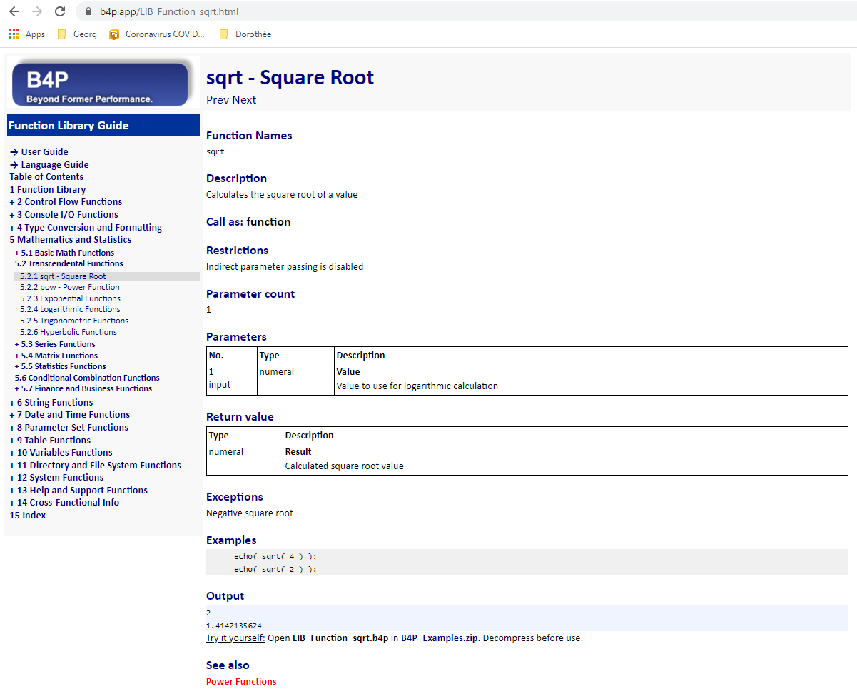
B4P Use Case Automatic documentation generation for website www.b4p.app
Inputs: Source Text (inside C program)
Output: Web contents
// sqrt
// ___________________________________________________________________________
/* B4PDOCU.START
"sqrt - Square Root" :
{
"Function Names": "sqrt",
"Keywords": "Square Root",
"Documentation": "Function Description",
"Description"::
Calculates the square root of a value
+++,
"Call as": "function",
"Parameter count": "1",
"Restrictions": "Indirect parameter passing is disabled",
"Parameters":
[
{ "Number": "1",
"Name": "Value",
"Direction": "input",
"Types": "numeral",
"Description": "Value to use for logarithmic calculation"
} ],
"Return value":
[
{ "Name": "Result",
"Types": "numeral",
"Description": "Calculated square root value"
}
],
"Exceptions": "Negative square root",
"Examples"::
echo( sqrt( 4 ) );
echo( sqrt( 2 ) );
+++,
"Output": "automatic",
"See also": "Power Functions"
}
B4PDOCU.STOP */
void function__sqrt(int bias, Token_List& p, Token_Entry& ret_val)
{
...
return;
}
Consistent structure
Clean tables
4P
B4P
Program examples
executed automatically
Smart cross-
referencing

Slide 26
B4P Use Case Automatic Document Generation for www.b4p.app using B4P
Catalog of Books
Short Excel File
Specifies all manuals to generate
Specifies location of source text for the different manuals
Catalogue
of Books
Preparation
Preparation
Load catalogue of books
User selects the book to generate
Excel
Text Collection
Scan all files in specified subdirectories for relevant contents for B4P documentation
C / C++
C / C++
Collecting all
raw texts
C / C++
Raw Inputs
Descriptions of B4P functions are documented in the C/C++ files in comments, using an enhanced JSON format.
Other contents such as introductory parts are described in additional text files, also using enhanced JSON format
C / C++ Source Code
/* ... Raw Docu inputs */
Master File
JSON
Verification
C / C++
✓
C / C++
Verification
Ensures that contents provided fulfill the structural guidelines
C / C++
Text Files
... Raw Docu inputs
Collect all keywords
Collect all Keywords
Structured handling of all keywords and function names allowing convenient cross referencing and index pages
Revolving Table of Contents
It puts all individual raw document sections into a given order and hierarchy level in the document
Both user and B4P program update this table mutually
Revolving
ToC
Load & process
Revolving ToC
Process Revolving ToC
Add titles of new contents into placeholders or at the bottom
Add further info (links, keywords)
Do chapter/section renumbering
Excel
Create HTML Navigator Bar
Generate HTML Navigation Bar
Left-hand menu to select section to see
Generate HTML contents
Formatted text and tables
Pictures included
Execute all B4P program examples automatically and add their outputs into the doc contents
Generate HTML Contents
www
@
Place all web
contents in
staging area
Staging Area
All files (HTML, JPG, style.css, PDF, etc.) are moved to the staging area, ready for one-mouseclick publication on the Internet: www.b4p.app
www

Slide 27
Variable Model Introduction
1
2
3
4
5
6
7
8
Import
Clean
Validate
Merge
Augment
Analyze
Format
Export
Search and Identify files to import
Download contents from web pages
Initiate database exports
Load data from files: Excel, CSV, HTML, XML, JSON, ZIP, TXT
Clean syntax
Check and align headers and structure
Explore and extract sub-tables
Filter out data not needed
Align number formats
Identify relevant data
Harmonize terminologies
Resolve inconsistencies
Fill missing data
Eliminate duplications
Merge multiple tables
Consolidate individual tables
Compare tables
Identify commonalities in multiple tables
Eliminate redundancies
Retrieve data from lookup tables
Add new calculated fields
Enrich the information value
Analyze
Calculate
Pivots
Sort contents
Develop time schedules
Do statistics
Align results
Sort and arrange rows and columns
Format numbers
Add style, formats and colors
Save data to files: Excel, CSV, HTML, XML, JSON, ZIP, TXT
Initiate database imports
Trigger other SW that data is available

Slide 28
B4P Solution Automate your data integration and analysis with a low-code analytics engine
Start Data Analysis Task
1
2
3
4
5
6
7
8
Ingest
Semantic
Alignment
Validate &
Explore
Merge &
Consolidate
Enrichment
Align and
process
Format
Save and
Export
From files, databases and the Internet
Excel
JSON
HTML, XML
CSV, TSV, ...
Text files and many more
Harmonize keywords and values
Align headers and overall structure
Align different number formats
Align deviating terminologies
Identify and extract data you need
Check all headers
Identify data
Resolve inconsistencies
Interpolate missing values
Identify and resolve duplications
Combine data from multiple tables
Eliminate redundant data
Fill information gaps
Enrich the information value
Consolidate
Analyze
Calculate
Pivot
Align
Sort
Sort and arrange rows and columns
Add style, formats and colors
Excel
HTML, XML
JSON
CSV, TSV
Text files and many more
B4P
Integrated analysis completed in seconds
Rapid, High Quality Results

Slide 29
Solution Automate your data integration and analysis with the B4P analytics engine
Many complex
data sources
X
X
B4P
Import
Clean
Validate
Merge
Augment
Analyze
Format
Export
Load data from files: Excel, CSV, HTML, XML, JSON, ZIP, TXT
Search and Identify files to import
Download contents from web pages
Initiate database exports
Clean syntax
Check and align headers and structure
Explore and extract sub-tables
Filter out data not needed
Align number formats
Identify relevant data
Harmonize terminologies
Resolve inconsistencies
Fill missing data
Eliminate duplications
Merge multiple tables
Consolidate individual tables
Compare tables
Identify commonalities in multiple tables
Eliminate redundancies
Retrieve data from lookup tables
Add new calculated fields
Enrich the information value
Analyze
Calculate
Pivots
Sort contents
Develop time schedules
Do statistics
Align results
Sort and arrange rows and columns
Format numbers
Add style, formats and colors
Save data to files: Excel, CSV, HTML, XML, JSON, ZIP, TXT
Initiate database imports
Trigger other SW that data is available
Integrated analysis completed in seconds

Slide 30
Solution Automate your data integration and analysis with the B4P analytics engine
Many complex
data sources
X
X
B4P
Import
Clean
Validate
Merge
Augment
Analyze
Format
Export
Search and Identify files to import
Download contents from web pages
Initiate database exports
Load data from files: Excel, CSV, HTML, XML, JSON, ZIP, TXT
Clean syntax
Check and align headers and structure
Explore and extract sub-tables
Filter out data not needed
Align number formats
Identify relevant data
Harmonize terminologies
Resolve inconsistencies
Fill missing data
Eliminate duplications
Merge multiple tables
Consolidate individual tables
Compare tables
Identify commonalities in multiple tables
Eliminate redundancies
Retrieve data from lookup tables
Add new calculated fields
Enrich the information value
Analyze
Calculate
Pivots
Sort contents
Develop time schedules
Do statistics
Align results
Sort and arrange rows and columns
Format numbers
Add style, formats and colors
Save data to files: Excel, CSV, HTML, XML, JSON, ZIP, TXT
Initiate database imports
Trigger other SW that data is available
Integrated analysis completed in seconds

Slide 31
Solution Automate your data integration and analysis with the B4P analytics engine
Many complex
data sources
X
X
1
2
3
4
5
6
7
8
Import
Clean
Validate
Merge
Augment
Analyze
Format
Export
Search and Identify files to import
Download contents from web pages
Initiate database exports
Load data from files: Excel, CSV, HTML, XML, JSON, ZIP, TXT
Clean syntax
Check and align headers and structure
Explore and extract sub-tables
Filter out data not needed
Align number formats
Identify relevant data
Harmonize terminologies
Resolve inconsistencies
Fill missing data
Eliminate duplications
Merge multiple tables
Consolidate individual tables
Compare tables
Identify commonalities in multiple tables
Eliminate redundancies
Lookup data from
reference data
Add calculated fields
Enrich the information value
Analyze
Calculate
Pivot
Sort
Statistics
Align results
Sort and arrange
rows and columns
Format fields
Add style, formats and colors
Save data to files: Excel, CSV, HTML, XML, JSON, ZIP, TXT
Initiate database imports
Trigger other SW that data is available
Integrated analysis completed in seconds

Slide 32
Solution Automate your data integration and analysis with the B4P analytics engine
Many complex
data sources
X
X
1
2
3
4
5
6
7
8
Import
Clean
Validate
Merge
Augment
Analyze
Format
Export
B4P
Search and Identify files to import
Download contents from web pages
Initiate database exports
Load data from files: Excel, CSV, HTML, XML, JSON, ZIP, TXT
Clean syntax
Check and align headers and structure
Explore and extract sub-tables
Filter out data not needed
Align number formats
Identify relevant data
Harmonize terminologies
Resolve inconsistencies
Fill missing data
Eliminate duplications
Merge multiple tables
Consolidate individual tables
Compare tables
Identify commonalities in multiple tables
Eliminate redundancies
Retrieve data from lookup tables
Add new calculated fields
Enrich the information value
Analyze
Calculate
Pivots
Sort contents
Develop time schedules
Do statistics
Align results
Sort and arrange rows and columns
Format numbers
Add style, formats and colors
Save data to files: Excel, CSV, HTML, XML, JSON, ZIP, TXT
Initiate database imports
Trigger other SW that data is available
Integrated analysis completed in seconds

Slide 33
Overview The B4P Data Integration and Analytics Engine
Many complex
data sources
Excel, XLS, CSV, XML, JSON, HTML, Zip, Text (and others)
X
Web data (websites, web services)
X
Database exports (Salesforce, Oracle, SAP, FileMaker)
Statistical data (R, SAS, SPSS, Stata)
B4P
2
3
4
5
6
7
8
Import
Clean
Validate
Merge
Augment
Analyze
Format
Export
Load data from files: Excel, CSV, HTML, XML, JSON, ZIP, TXT
Search and Identify files to import
Download contents from web pages
Initiate database exports
Clean syntax
Check and align headers and structure
Explore and extract sub-tables
Filter out data not needed
Align number formats
Identify relevant data
Harmonize terminologies
Resolve inconsistencies
Fill missing data
Eliminate duplications
Merge multiple tables
Consolidate individual tables
Compare tables
Identify commonalities in multiple tables
Eliminate redundancies
Retrieve data from lookup tables
Add new calculated fields
Enrich the information value
Analyze
Calculate
Pivots
Sort contents
Develop time schedules
Do statistics
Align results
Sort and arrange rows and columns
Format numbers
Add style, formats and colors
Save data to files: Excel, CSV, HTML, XML, JSON, ZIP, TXT
Initiate database imports
Trigger other SW that data is available
Integrated analysis completed in seconds

Slide 34
Overview The B4P Data Integration and Analytics Engine
Many complex
data sources
Excel, XLS, CSV, XML, JSON, HTML, Zip, Text (and others)
X
Web data (websites, web services)
X
Database exports (Salesforce, Oracle, SAP, FileMaker)
Statistical data (R, SAS, SPSS, Stata)
B4P
2
3
4
5
6
7
8
Import
Clean
Validate
Merge
Augment
Analyze
Format
Export
Load data from files: Excel, CSV, HTML, XML, JSON, ZIP, TXT
Search and Identify files to import
Download contents from web pages
Initiate database exports
Clean syntax
Check and align headers and structure
Explore and extract sub-tables
Filter out data not needed
Align number formats
Identify relevant data
Harmonize terminologies
Resolve inconsistencies
Fill missing data
Eliminate duplications
Merge multiple tables
Consolidate individual tables
Compare tables
Identify commonalities in multiple tables
Eliminate redundancies
Retrieve data from lookup tables
Add new calculated fields
Enrich the information value
Analyze
Calculate
Pivots
Sort contents
Develop time schedules
Do statistics
Align results
Sort and arrange rows and columns
Format numbers
Add style, formats and colors
Save data to files: Excel, CSV, HTML, XML, JSON, ZIP, TXT
Initiate database imports
Trigger other SW that data is available
Integrated analysis completed in seconds

Slide 35
B4P Solution Automate your data integration and analysis with the B4P analytics engine
Many complex
data sources
X
X
B4P
1
2
3
4
5
6
7
8
Import
Clean
Validate
Merge
Augment
Analyze
Format
Export
Load data from:
Excel, CSV, HTML, XML, JSON, ZIP, TXT
Load data from
web links
Load data from
database exports
Search and Identify other files to import
Clean syntax
Check and align headers and structure
Explore and extract sub-tables
Filter out data not needed
Align number formats
Identify relevant data
Harmonize terminologies
Resolve inconsistencies
Fill missing data
Eliminate duplications
Merge data from multiple tables
Consolidate within
individual tables
Compare tables
Identify commonalities in multiple tables
Eliminate redundancies
Retrieve data from lookup tables
Add new calculated fields
Enrich the information value
Analyze
Calculate
Pivots
Sort contents
Statistics
Align results
Sort and arrange rows and columns
Format numbers
Add style, formats and colors
Save data to: Excel, CSV, HTML, XML, JSON, ZIP, TXT
Initiate database imports
Trigger other software that
data is available
Integrated analysis completed in seconds

